Slide 1
MINOR PROJECT “Student‘s Record”
Submitted By Internal Guide
Yogesh Kumar Mr. Pushpendra Singh
RajKamal Assistant Professor
Dushayant Kumar B.C.A. Department
B.C.A. 5th Semester (Session: February, 2021)
Department of B.C.A.
S.S.P.G College, Shikarpur

Slide 2
TOPIC WISE “Project Work Distribution”
Abstract of Proj: Yogesh Kumar
Java Features : Raj Kamal
SQL Query : Dushayant Kumar

Slide 3
ABSTRACT
To Develop a Students Record, We take care of Student`s Personal information, Academic information and Personal University identity information.
We save Student’s Record in the database, record view from database, record update in the database and record delete in the database.

Slide 4
SCREEN SHOTS
OF
PROJECT

Slide 5
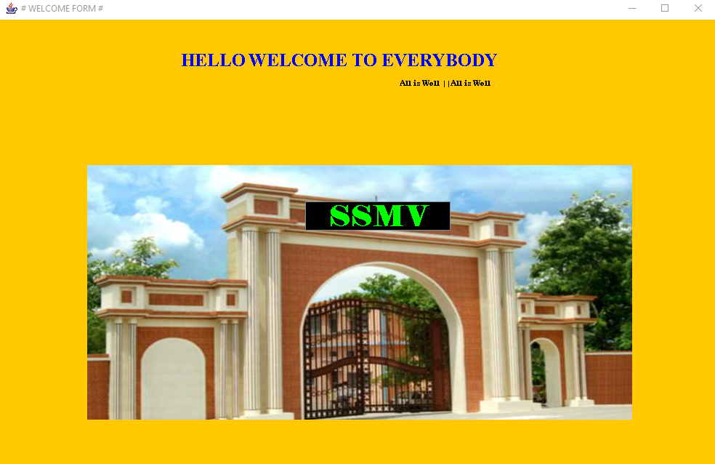
WELCOME FORM

Slide 6
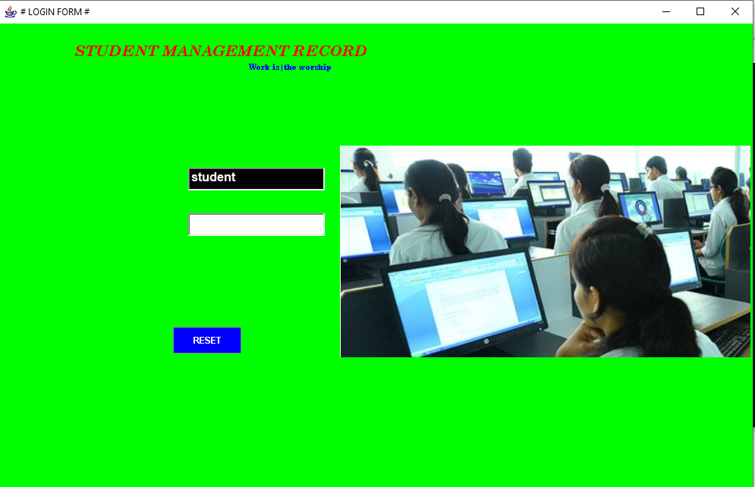
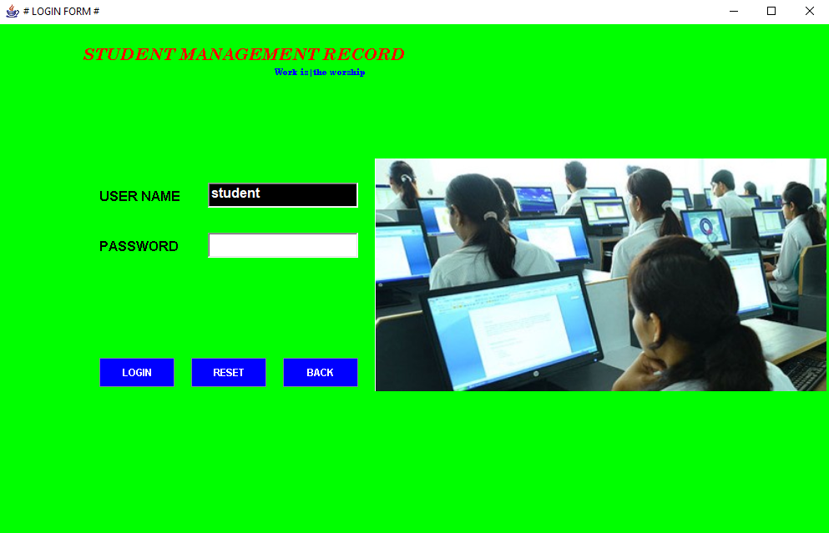
LOGIN FORM

Slide 7
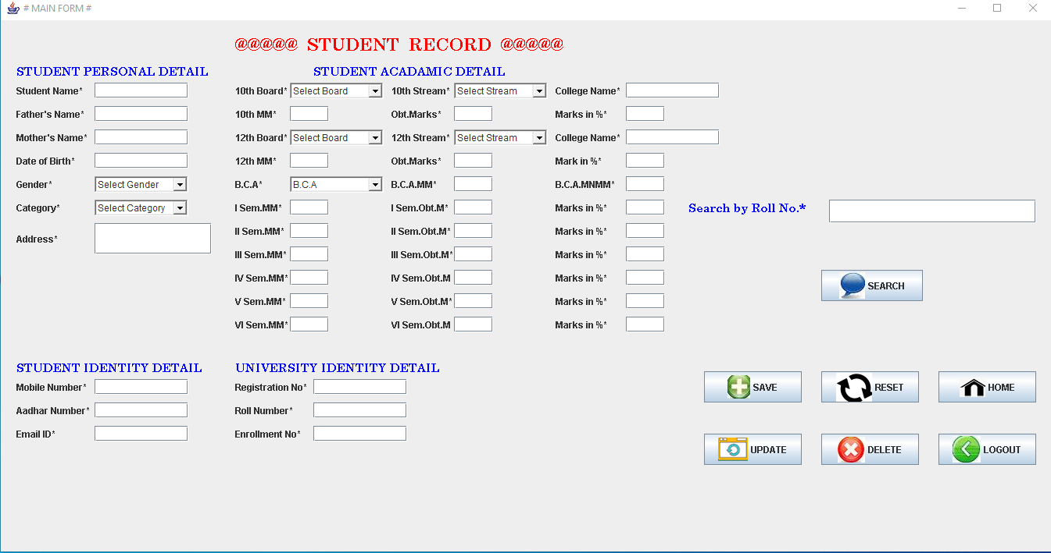
MAIN FORM

Slide 8
SCREEN SHORTS
OF
TABLE

Slide 9
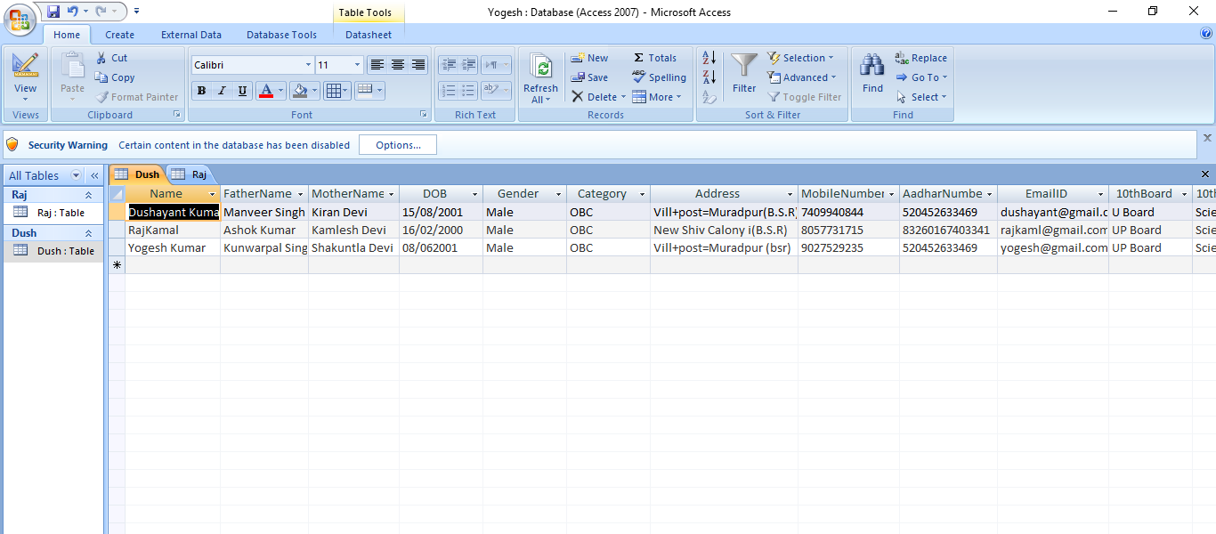
MAIN TABLE

Slide 10
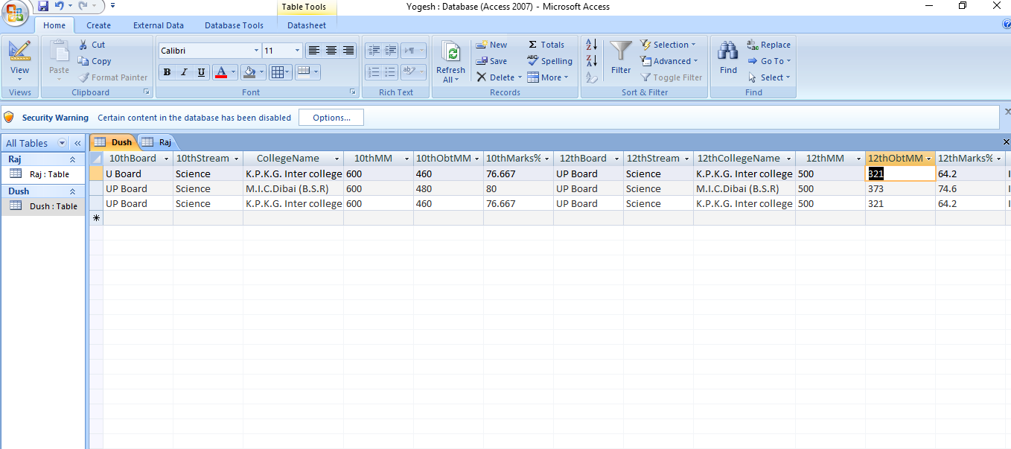
MAIN TABLE

Slide 11
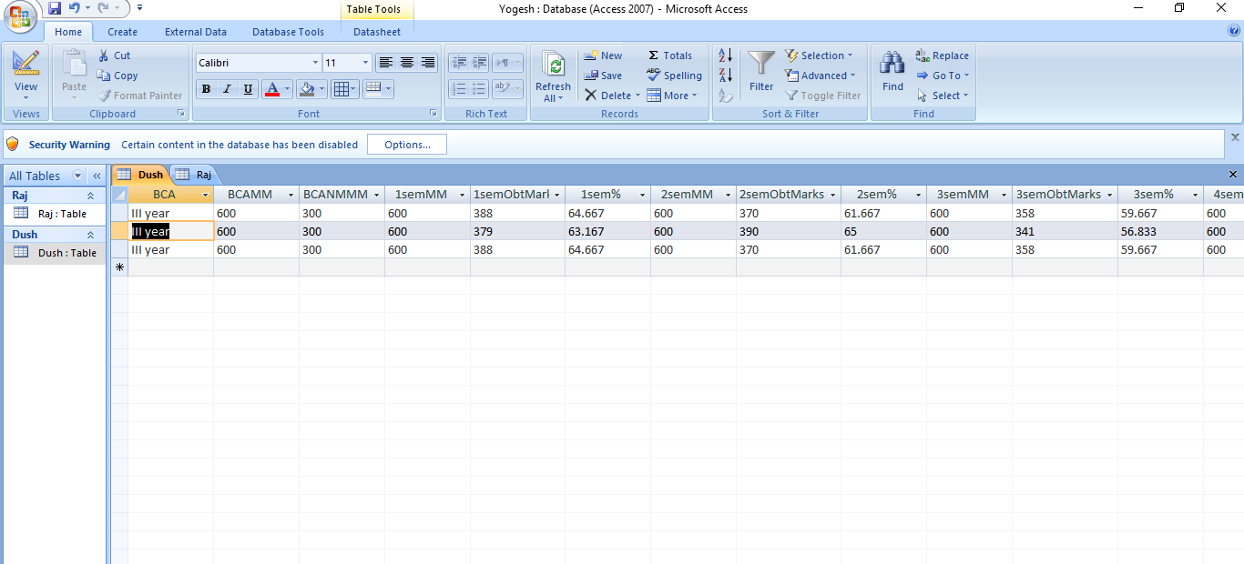
MAIN TABLE

Slide 12
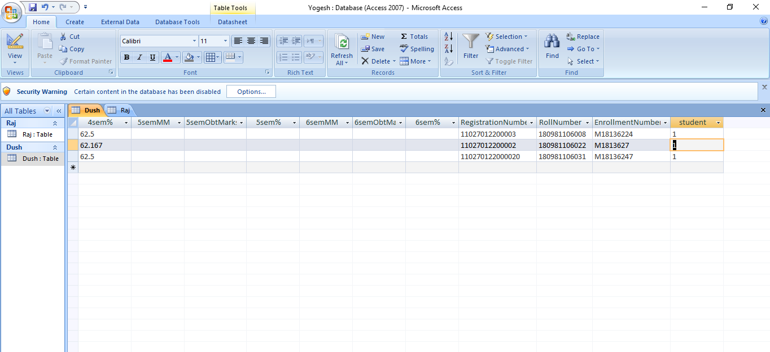
MAIN TABLE

Slide 13
Introduction of java…
Java is a powerful object oriented programming language .
It is also called machine independent programming language because java of program can be run any operating system .
It is developed by James Gosling in 1991 at sunmicrosystem .
Java of syntex is similar to C and C++ but java is strictly object oriented programming language .

Slide 14
FEATURES OF JAVA
Platform independent
Simple
Secure
Robust
Multithread

Slide 15


Platform independent
Java of program can be run any operating System .
JVM convert the byte code into machine level language .
So JVM and byte code is main features to make machine independent language .

Slide 16
Simple
It has no pre-processor.
It has no library files.
It has no global variable.
It has no go to statement.
It is very simple because.
It has no pointer

Slide 17
Secure:
It has more secure because JVM convert the byte code into machine level language .
The user can take only byte code another System.

Slide 18
Robust
Small-small exceptions can be handle throw by JVM.
So very few chance to cares the software in our life .

Slide 19

Multithread:
A big process can be automatically divided into small-small task and execute at a time that is called Multithread .

Slide 20
Software and Hardware Requirements
Software Requirements:
Platform - Windows (10,8 and window 7/XP)
Software - JDK 6.0
Front End - JAVA
Back End - Ms-Access.
Hardware Requirements:
Processor - Intel Processor with 2.0 GHz
RAM - 256 MB
Hard Disk - 40 GB
Keyboard - 101 keys
Mouse - Any pointing device

Slide 21
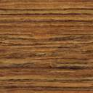
SQL QUERY
insert : save the data in DB.
select : view / search data. from DB.
update : modify the data in DB.
delete : remove the data from DB.

Slide 22

1# Insert Query:
use for insert any data in the table.
Syntax: insert into table name values(?,?);
Example==================
String name = “Yogesh Kumar”;
String fName = “K.P Singh”;
insert into student values (name, fName);
Note: student is a table name

Slide 23
2# Select Query:
user for search / view any data from the table / database.
Syntax: select * from table name where name = ?;
Example====================
select * from student where name = “Yogesh Kumar”;
Note: student is a table name

Slide 24
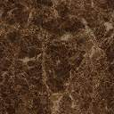
3# Update Query:
use for update any data in the table / database.
Syntax: update table name set name=? where name = ?;
Example====================
update student set name=“Yogesh”
where name = “Yogesh Kumar”?;
Note: student is a table name.

Slide 25
4# Delete Query:
use for delete any data from the table / database.
Syntax: delete from table name where name = ?;
Example====================
delete student where name = “Yogesh”?;
Note: student is a table name

Slide 26
ROLE IN THIS PROJECT
Proj. Report : Yogesh Kumar
Coding : Yogesh Kumar
Data Base : Raj Kamal
SQL Query : Dushayant Kumar
PPT : Dushayant Kumar

Slide 27


Slide 28
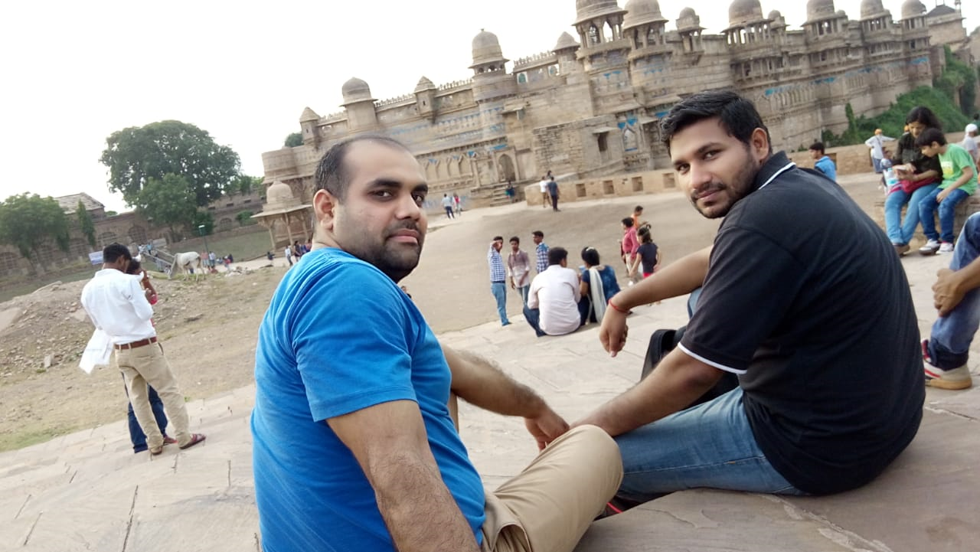

Slide 29
ANY
Question
?

Slide 30
THANKS

